Slide 1

Customer Behavior Analysis Report
This report dives into customer shopping behavior using a dataset of 3,900 transactions. Our goal is to uncover purchasing patterns, demographics, product performance, and the impact of subscriptions.

Slide 2


Key Insights
Clothing Dominates
Highest revenue-generating category.
Subscribers Spend More
Higher average spend and total revenue.
Young Adults are Key
Most valuable customer segment.

Slide 3

Exploratory Data Analysis (EDA)
EDA was performed using Python (Pandas) to assess data quality, structure, and key statistical properties.
Dataset Overview
Total records: 3,900
Total features: 18
Numerical: Age, Purchase Amount, Review Rating, Previous Purchases
Categorical: Gender, Category, Shipping Type, Subscription Status
Initial Exploration
Summary statistics revealed an average age of ~44 years, average purchase of ~$59.76, and an average review rating of ~3.75.

Slide 4

Data Cleaning & Engineering
1
Missing Data Handling
37 missing review ratings were imputed using the median rating per product category.
2
Column Standardization
Column names converted to snake_case; 'purchase_amount_(usd)' renamed to 'purchase_amount'.
3
Feature Engineering
New 'age_group' column created (Young Adult, Adult, Middle-aged, Senior).
4
Data Consistency
Redundant 'promo_code_used' column dropped.

Slide 5

Database Integration & Key EDA Insights
Database Integration
Key EDA Insights
The cleaned dataset was successfully loaded into PostgreSQL using SQLAlchemy for advanced SQL analysis.
Average purchase amount: $59.76
Average review rating: 3.75
Majority of customers are male.
Clothing is the most frequently purchased category.
Most customers are repeat buyers.

Slide 6




Data Analysis Using SQL
Business-driven analytical queries were performed in PostgreSQL to extract deeper insights.
Revenue by Gender
Male customers generate higher total revenue due to transaction volume.
Discount Effectiveness
Discounts don't always reduce revenue; some users still spend above average.
Product Performance
Top 5 products have high average review ratings, indicating satisfaction.

Slide 7

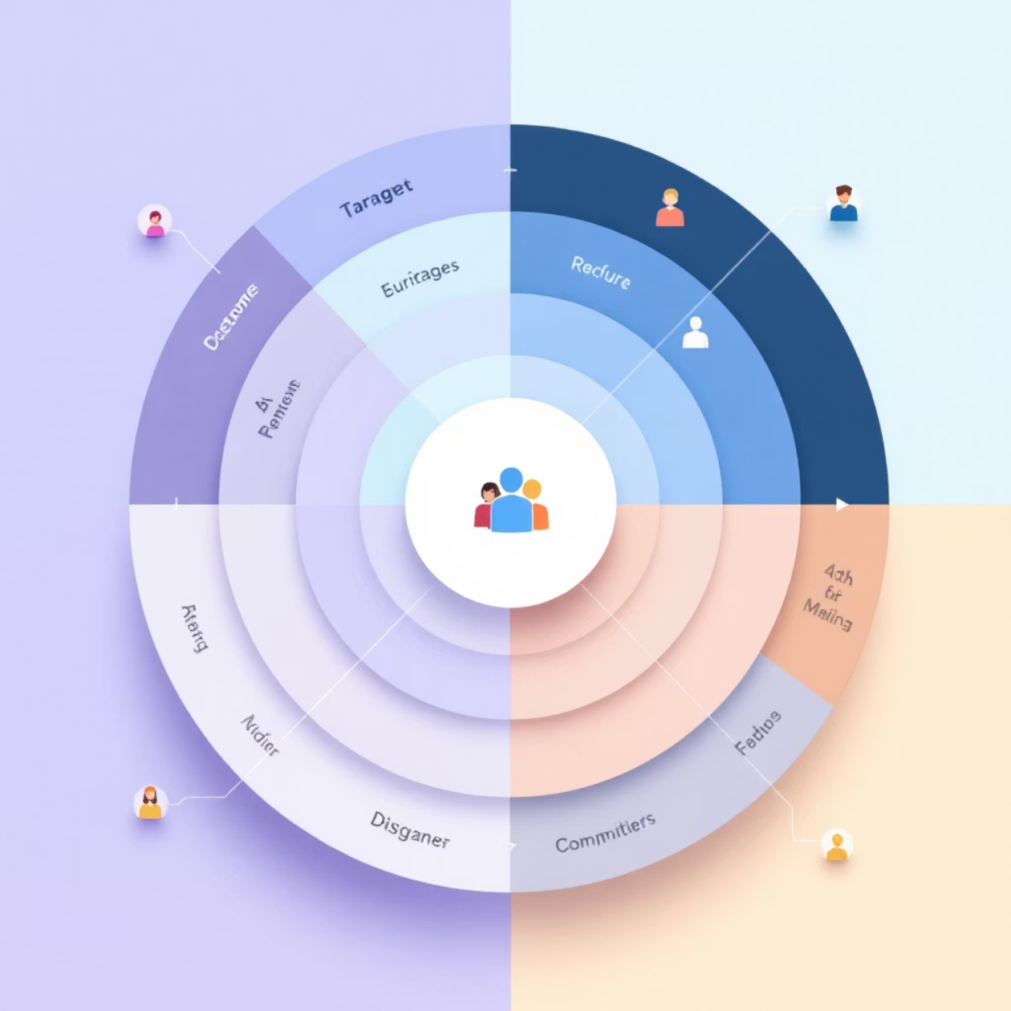
Subscription & Segmentation
Subscription Impact
Customer Segmentation
Subscribed customers spend more on average.
New customers (1 purchase)
They generate higher total revenue.
Returning customers (2–10 purchases)
Represent a smaller but more valuable segment.
Loyal customers (>10 purchases)

Slide 8
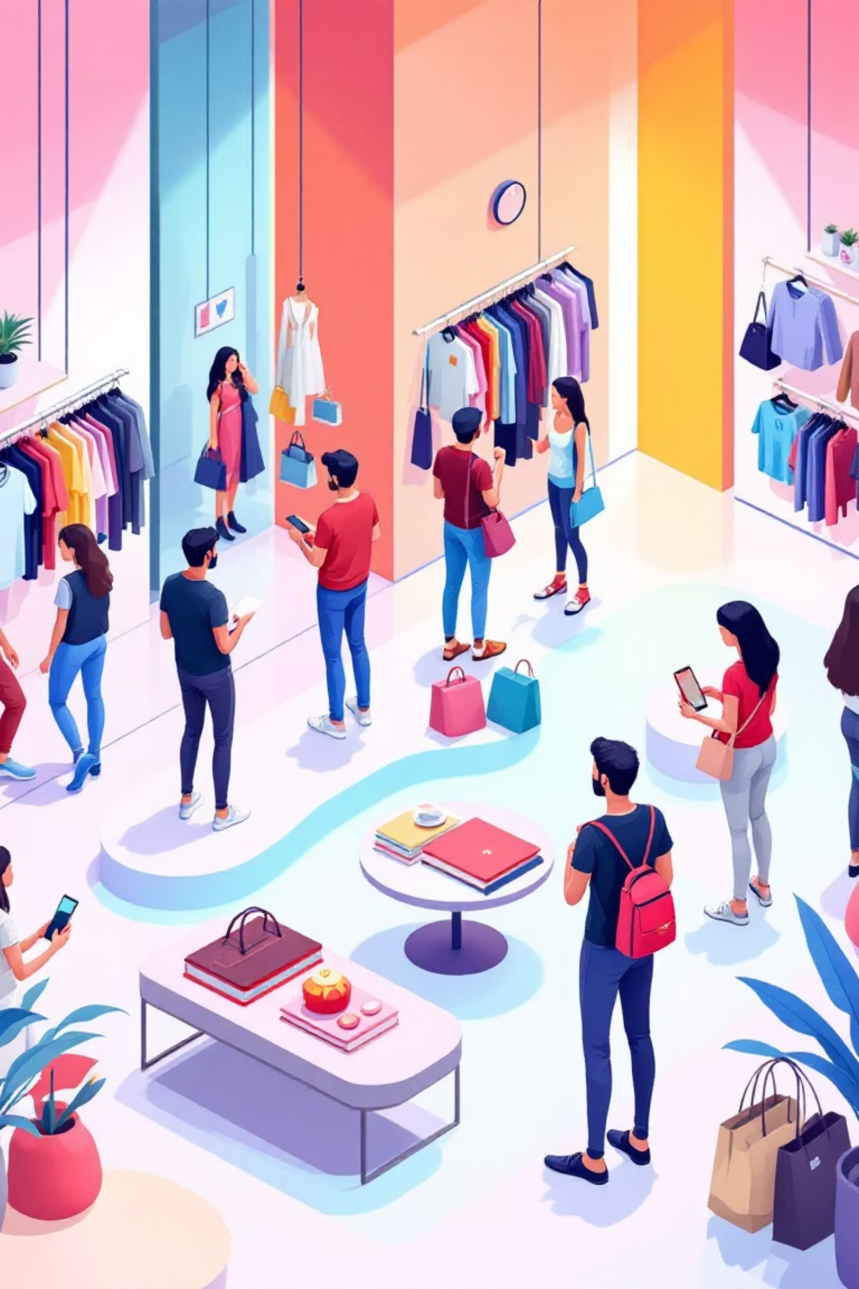
Category & Age Group Contribution
Category-Level Insights
Clothing dominates sales volume and revenue, followed by Accessories and Footwear.
Age Group Revenue
Young Adults contribute the highest total revenue among all age groups.

Slide 9
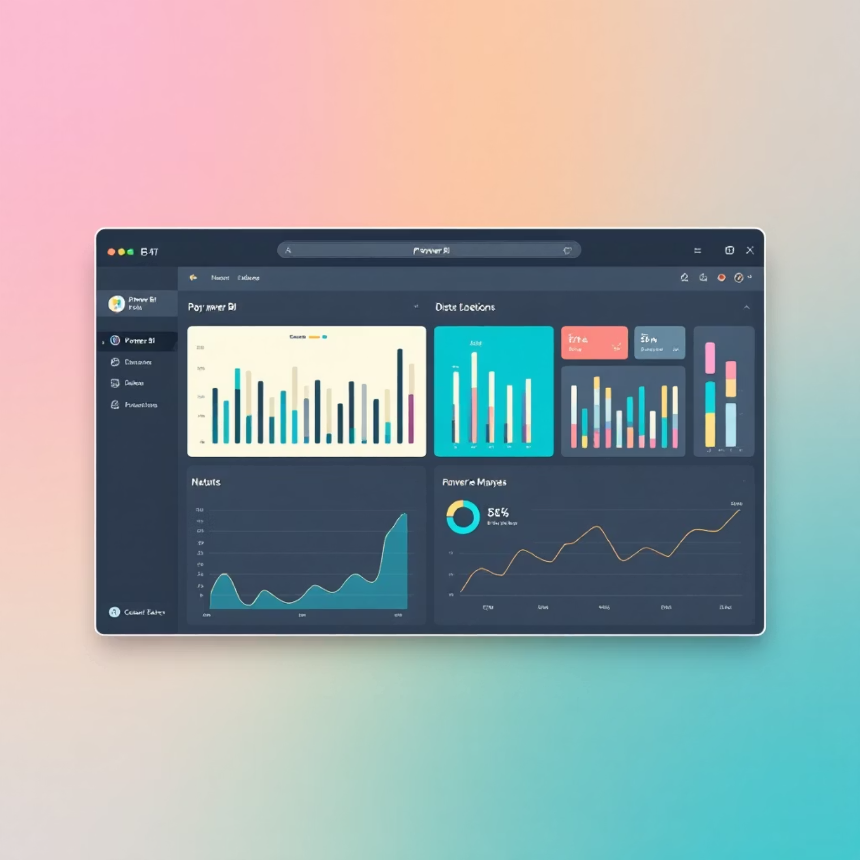
Interactive Dashboard
An interactive Power BI dashboard visualizes customer behavior and business KPIs.
Dashboard Highlights
Total customers: ~3.9K
Average purchase amount: ~$59.76
Average review rating: ~3.75
Subscription distribution: 73% Non-subscribers, 27% Subscribers
Dynamic filtering by gender, category, subscription status, and shipping type enables deeper analysis.

Slide 10
Business Recommendations
01
02
Focus on Clothing
Expand Subscriptions
Allocate more inventory and marketing resources.
Encourage repeat buyers with targeted offers.
03
04
Optimize Discounts
Target Young Adults
Use strategically on high-performing products.
Design personalized campaigns for this high-revenue segment.
05
06
Promote Top Products
Retention Marketing
Leverage high-rated items with premium positioning.
Develop loyalty programs for returning customers.

